Slide 1
FINAL PROJECT cs 2704
Name : Mike Mico
Student Id: 3685120

Slide 2



CHINA
CAMBODIA

Slide 3
IN THE PREVIOUS SLIDE WE SEE 2 COUNTRIES
ONE OF THE COUNTRIES LOOKS WEALTHIER THAN THE OTHER
WE COULD MEASURE STATISTICALLY BY LOOKING AT GNI ( GROSS NATIONAL INCOME)

Slide 4
WHAT IS GNI?
Gross National Income (GNI) is the total amount of money earned by a nation's people and businesses. It is used to measure and track a nation's wealth from ..
The following link shows some countries with their GNI’s along with other interesting data
https://datatopics.worldbank.org/debt/ids/countryanalytical/chn/counterpartarea/wld

Slide 5
Total Ext. Debt Stocks
Debt when talking about countries refers specifically to the external debt these countries owe to developed countries and multilateral lending institutions.
IT STANDS TO REASON THAT DEBT COULD ALSO BE USED TO MEASURE COMPARE COUNTRIES WEALTH.

Slide 6
GNI VS EXTERNAL DEBT
COUNTRY | TOTAL EXTERNAL DEBT | GNI
CHINA | 2,349,388.6 | 14,618,341.4
ECUADOR | 56,190.5 | 95,983.6
CAMBODIA | 17,562.1 | 24,798.2
BRAZIL | 549,234.3 | 1,417,068.7

Slide 7

By looking at the previous examples from the data set, I made an interesting observation
From this I can come up with a hypothesis

Slide 8
HYPOTHESIS
Total external debt has a correlation with Gross National Income
Data set : https://data.worldbank.org/

Slide 9
EXPECTED OUTPUT
Based on a country’s total external debt we can make reasonable guess to their GNI and vice versa. (LINEAR)

Slide 10
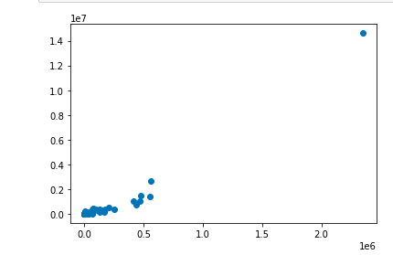
SCATTER PLOT
Y-axis: GNI
X- axis : Total Ext.Debt

Slide 11
Revised Hypothesis
After making a scatter plot of the data.
There appears to be an exponential growth in GNI based on debt.
Revised: The greater the external debt, the greater the GNI.

Slide 12
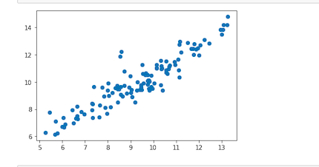
Log-log scatterplot
Y-axis: GNI
X- axis : Total Ext.Debt

Slide 13
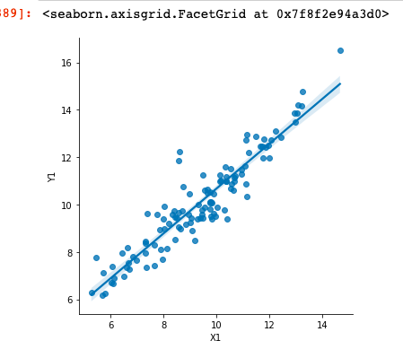
Linear Regression
Y-axis: GNI
X- axis : Total Ext.Debt

Slide 14
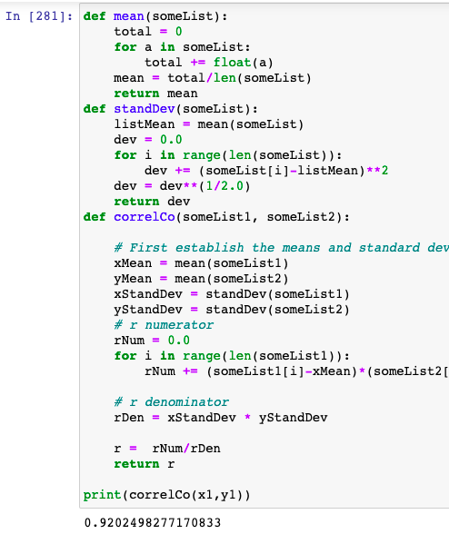
Evidence of corelation

Slide 15

Conclusion
There is a strong correlation with an r-value of 0.92
The relationship is an exponential growth

Slide 16


